Slide 1
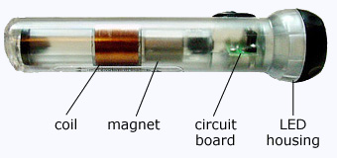
Section 11: Electromagnetic Induction

Slide 2
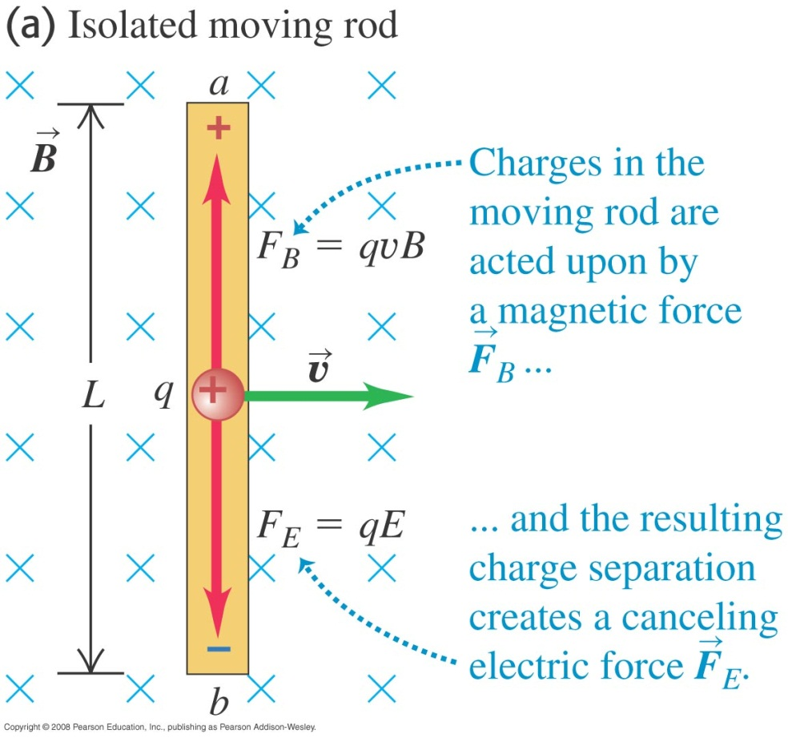
A Moving Rod: Motional EMF

Slide 3
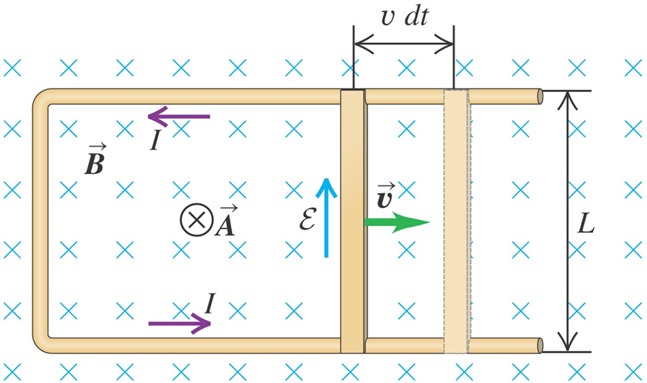
The Slide-wire Generator
Qualitative Result: Current Flows!

Slide 4
The Slide-wire Generator: Example Problem 1

Slide 5
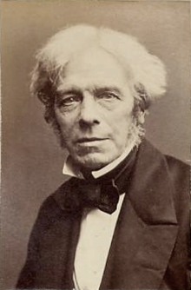
Faraday’s Three Experiments
In 1831, British physicist Michael Faraday performed experiments which can be put into three general categories

Slide 6
Faraday’s Three Experiments: Faraday’s Law
Pull a loop of wire through a magnetic field. Current flows. (DEMO!)
Move a magnet across a stationary loop. Current flows. (Demo!!)
Change the strength of the magnetic field in the loop. Current flows! (DEMO!!!)

Slide 7

Faraday’s Law Generalized
All can be explained by
$$ε=−\frac{dΦ_{B}}{dt}$$

Slide 8
Lenz’s Law
The induced current produces its own magnetic flux which opposes the change in flux that induced the current
Shorter version:
Nature resists a change in flux!

Slide 9

Slidewire generator: Example II

Slide 10
Activity: Changing Magnetic Field

Slide 11
Lenz’s Law Demo
Ring Launcher

Slide 12
Activity: Alternator

Slide 13
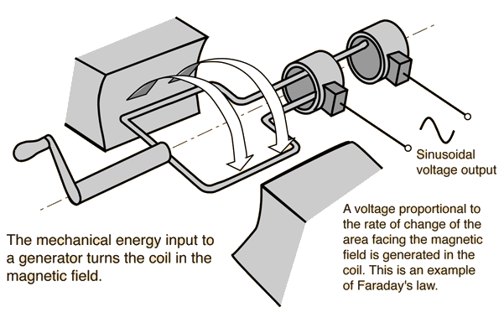
Play with Generators!

Slide 14
EXAM 3
MOVED FROM TUESDAY APRIL 2 to THURSDAY APRIL 4

Slide 15
Induced Electric Field
What kind of force could induce stationary charges to move??? (Hint: Not a magnetic force!)
Faraday hypothesized the following:
A changing magnetic flux induces an electric field

Slide 16
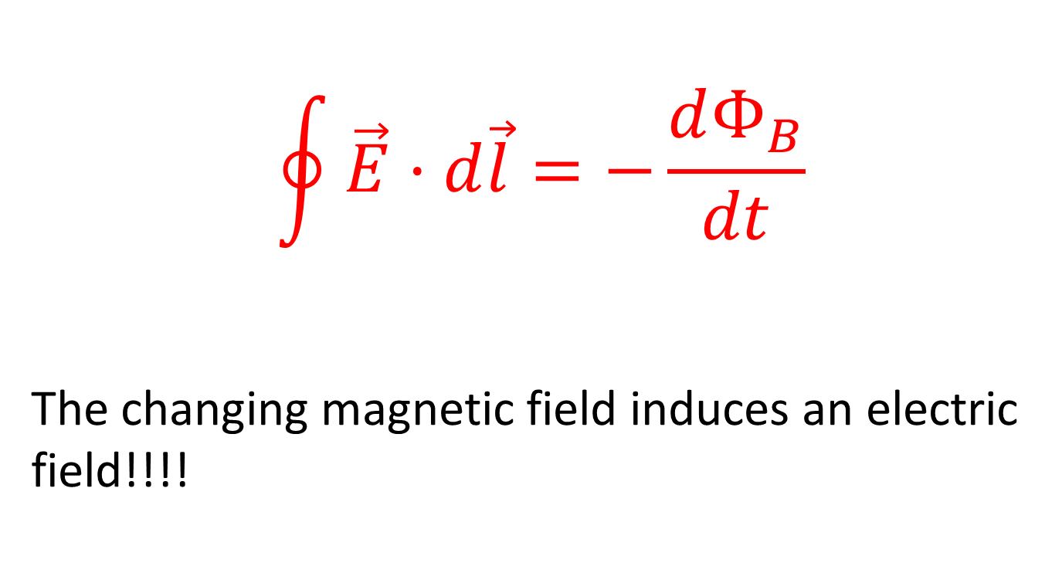
Faraday’s Law in a Different Form!
$$\oint{\vec{E}·d\vec{l}}=−\frac{dΦ_{B}}{dt}$$
The changing magnetic field induces an electric field!!!!

Slide 17

Demo: The “Faraday” Flashlight

Slide 18
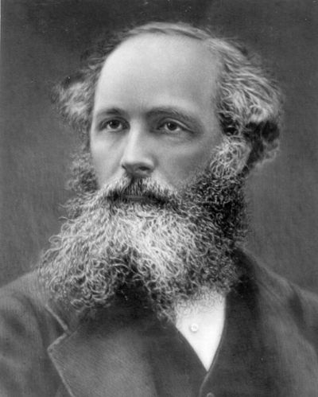
James Clerk Maxwell

Slide 19

Ampere’s Law Corrected
$$\oint{\vec{B}·d\vec{l}}=μ_{0}\left(i_{C}+ε_{0}\frac{dΦ_{E}}{dt}\right)$$

Slide 20
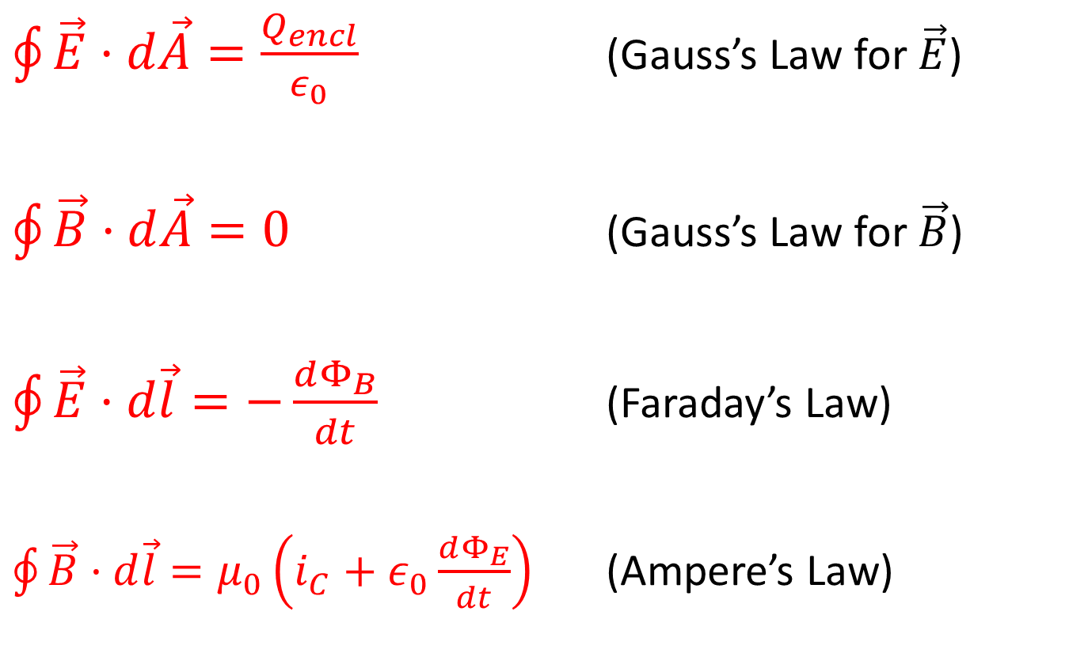
Maxwell’s Laws: Complete!
$\oint{\vec{E}·d\vec{A}=\frac{Q_{encl}}{ε_{0}}}$ (Gauss’s Law for $\vec{E}$)
$\oint{\vec{B}·d\vec{A}=0}$ (Gauss’s Law for $\vec{B}$)
$\oint{\vec{E}·d\vec{l}}=−\frac{dΦ_{B}}{dt}$ (Faraday’s Law)
$\oint{\vec{B}·d\vec{l}}=μ_{0}\left(i_{C}+ε_{0}\frac{dΦ_{E}}{dt}\right)$ (Ampere’s Law)

Slide 21

The Lorentz Force Law
$${\vec{F}}_{electromagnetic}=q(\vec{E}+\vec{v}×\vec{B})$$

